Slide 1
The Right Note
By: Andrew DeHaven
Rabiah Hogans
Juan Santoyo
Jeffrey Chan

Slide 2
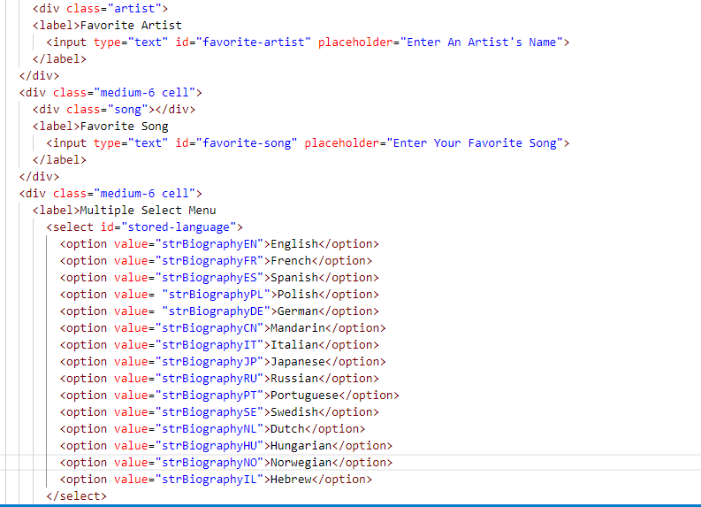
HTML/CSS
Foundations
(Framework used)
HTML

Slide 3
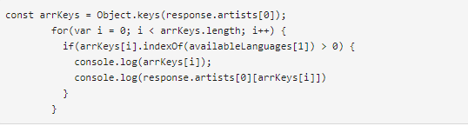
Javascript/Jquery
Added the on click function for each API call.
Called the API using an Ajax call

Slide 4
Local Storage/API
Set up APIs and adding the artists to the local storage per user request.
Lyrics.ovh
https://www.theaudiodb.com/

Slide 5
Group Challenge
Bring all our pieces together
The results div wouldn't clear out when we added a new artists
Created a dynamic object in a for loop. Then parsing through the object and adding it as an array.

Slide 6
Future Features
When the page loads, it displays the desired search history.
Add CSS Gradient to the site title.
Add Google Fonts to project.
Created a link that would play the song on Youtube or Spotify.

Slide 7
Questions?

Slide 8
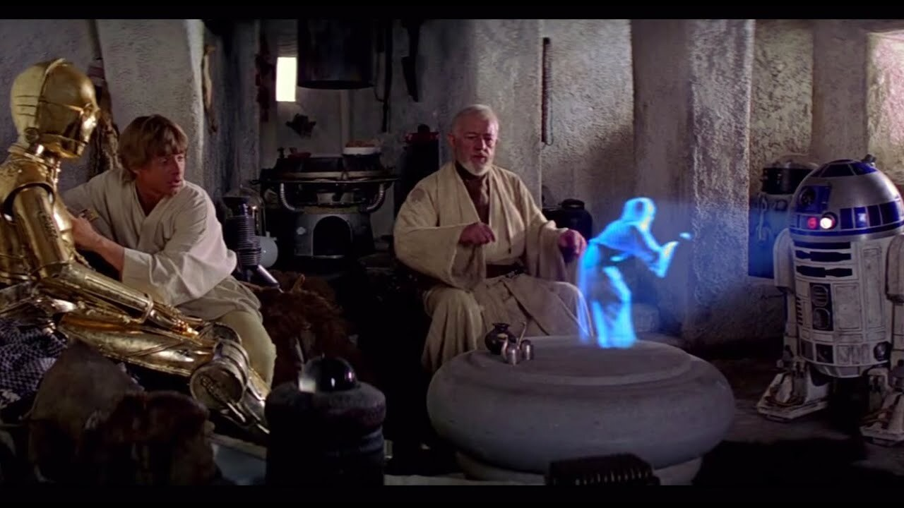
SPECIAL SHOUT OUT
“Help me Peter Wan Kenobi Your Our Only Hope!!!”

